Slide 1
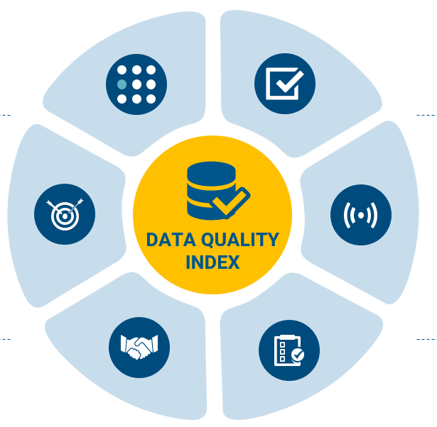

Institute of Software Engineering (ISTE) Software Quality and Architecture Group (SQA)
Topic 06 Evaluation of Data Quality Assessment
Kuang Yu Li
Source: Delta Partners
15.02.2021
Seminar „Advanced Software Engineering“
Notes:
Self-Introduction

Slide 2
Motivation
Automated data collection tools, Database technology, Internet
Tremendous amounts of data
Drowning in information
Starving for knowledge!
Data quality, methodology, application
Data-driven research!
Notes:
Project Manager: Andy! Scenario Automated Build System: running unit test, regression test (ex. 10 project)
All the test needed? What is the most important test? Who is responsible for making most error?
Problem: only information no insights, no decision
Scientific Approach
Do we have good data?
How could we used data?
Need for data science skills

Slide 3
Introduction
Application
TravisTorrent
Data set
Data Quality Fundamentals
Assessment Methodologies Overview
Data Quality Assessment
Notes:
Research Focuses:
Data properties for assessment
An overview of data quality assessment methods
DQ Improvement methods
DQ in Context of Continuous Integration

Slide 4



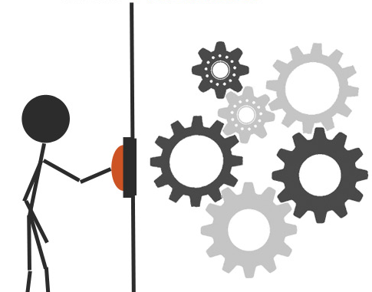
Data Quality Fundamentals
structured
semi-structured
unstructured
Kuang-Yu Li was born in Taipei,
Capital of Taiwan
Kuang-Yu | Li | Taipei | Taiwan
Data
Quality
Type
Problem
Dimension
Dimension
Element
Indicator
<PersonData>
<Name>Kuang-Yu,Li</Name>
<Birth>Taipei, Taiwan<Birth>
</PersonData>
Context
Perspective
Independent
Dependent
Data
User
source: [15’ Cai][11’Borek], BrightonSEO
Notes:
2.1 Data Types
Pre-defined tuple in a table
Text in a file
XML: extensible markdown language, info set
2.2 Data Quality Problems
Perspective
Context
Example
The information is inaccessible (user, context-independent)
Credible organization: The information is of doubtful credibility (user, context-dependent)
Missing data (data, context-independent)
MySQL, SQLite Violation of constraints provided by the database administrator (data, context-dependent)
2.3 Hierarchy
Subdivided into Elements, Element is a indicators of certain problem
2.3 Data Quality Dimensions
https://www.slideshare.net/sandersal1/brightonseo-structured-data-by-alexis-sanders?from_action=save

Slide 5



Dimension, Element, Indicators
Availability
Accessibility
Timeliness
Usability
Credibility
Reliability
Accuracy
Consistency
Completeness
Relevance
Fitness
Presentation Quality
Readability
Integrity
source: [15’ Cai], Java Tutorial, pipedrive
Notes:
Availability
Credibility: Experts or specialists regularly audit and check the correctness of the data content
Consistency: After data have been processed, their concepts, value domains, and formats still match as before processing
Completeness: missing attribute of a data
Fitness: match to the business/research need
Readability: data clear and understandable

Slide 6
Assessment Methodology Overview
Define
Measure
Analyze
Improve
Phases
Strategy
Cost
Data-driven
Process-driven
Process cost
Opportunity cost
State Reconstruct
Assessment
Improvement
source: [09’Batini]
Notes:
3.1 Phases and Steps
State Reconstruction: collecting contextual information, optional
Assessment: measuring the quality of data collections along relevant quality dimensions;
Requirements analysis, DQ Measurement, Process Modeling … etc
Improvement: selection of the steps, strategies, and techniques
Cost Evaluation, Process Assignment, Data Responsibility, Selection of Strategies and Techniques
3.2 Strategies and Techniques
Data-Driven
Acquisition of New Data, Standardization, Record Linkage, Data and Schema Integration, Source Trustworthiness, Error Localization and Correction … etc
Process-Driven
Process control: inserts checks and control procedures when date created
Process redesign: removes activity cause of poor quality and new activity
Cost
Process Cost: associated with the re-execution of whole process due to data errors;
Opportunity Cost: lost and missed revenues.
Strongly context-dependent: evaluation dependent on application
ex. obsolete information on a stock for trader and newspaper reader
The cost of poor data quality is strongly context-dependent as opposed to the cost of a data quality program.
For example: wrong stock price for an active trader vs a newspaper receiving the same obsolete information to publish monthly trading reports may not experience any economic loss.

Slide 7
Classification
Cost
Complete
TIQM
CDQ
Economic
COLDQ
Assessment
Improvement
Operational
TDQM
DWQ
ISTAT
DoQuinCIS
AIMQ
CIHI
DQA
AMEQ
QAFD
IQM
Audit
source: [09’Batini]
Dimensions
Notes:
—complete methodologies, which provide support to both the assessment and improvement phases, and address both technical and economic issues;
—audit methodologies, which focus on the assessment phase and provide limited support to the improvement phase;
—operational methodologies, which focus on the technical issues of both the assessment and improvement phases, but do not address economic issues.
—economic methodologies, which focus on the evaluation of costs.

Slide 8
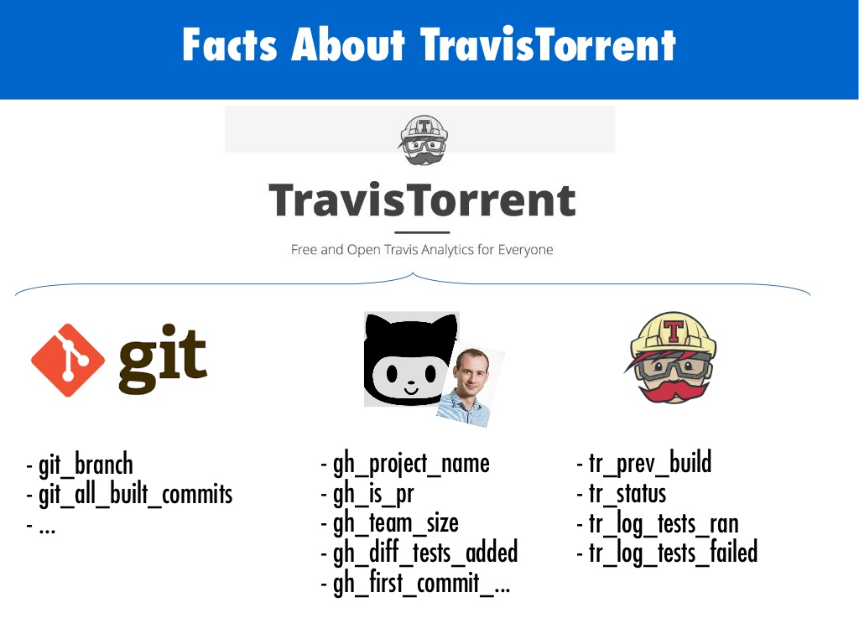
DQ in Context of Continuous Integration
Using CI is a known best practice …
How long is a CI run helpful?
How many regression tests it reduces?
TravisTorrent
Dataset
GitHub
API
GHTorrent
Database
Travis CI
Popular: star & watcher
11M rows, 1200 projects
Ruby or Java
non-fork, non-toy
Source: [17’Beller], Travis CI
Notes:
Is there a evidence to support CI?
Data set synthesized with meta data from Travis CI’s API
non-fork, non-toy, popular > 10 watchers,
a history of TRAVIS CI use > 50 builds
Java and Ruby only (2nd and 3rd, respectively on GITHUB )
11M rows
1265 projects
Travis CI: CI platform for Open-Source Software (OSS) development.
Tight integration with Github: do “full-stack research” from an analysis of build logs to repositories.
GHTorrent:
GHTorrent monitors the Github public event time line. For each event, it retrieves its contents and their dependencies, exhaustively. It then stores the raw JSON responses to a MongoDB database, while also extracting their structure in a MySQL database.
git commit: SHA1 Hash of the commit which triggered this build (should be unique world-wide)
gh is pr: Whether this build was triggered as part of a pull request on GitHub
tr_status: Build status (pass, fail, errored, canceled)
tr_prev_build: Serialized link to the previous build, by giving its tr build id tr_tests_ran: Whether tests ran in this build
Tr_tests_failed: Whether tests failed in this build
Best practice of modern software development
Goal: improve productivity, validate software faster release with more confidence
Two sides:
Build and unit testing stages of the software release process
Automated software release process for each change

Slide 9
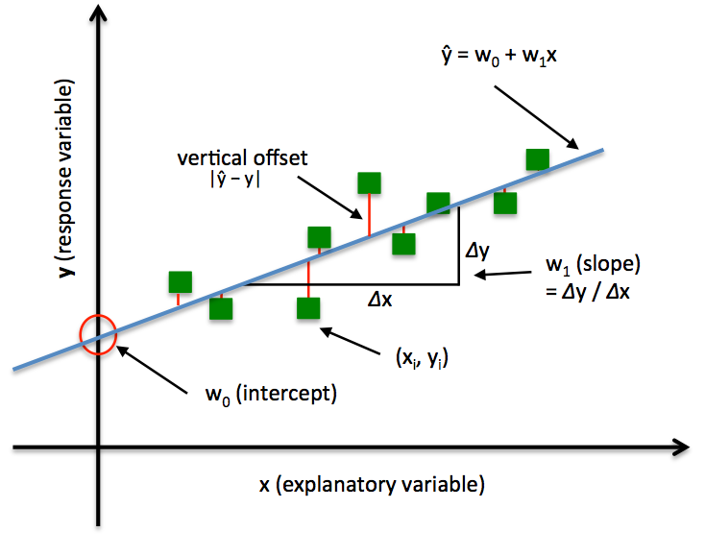
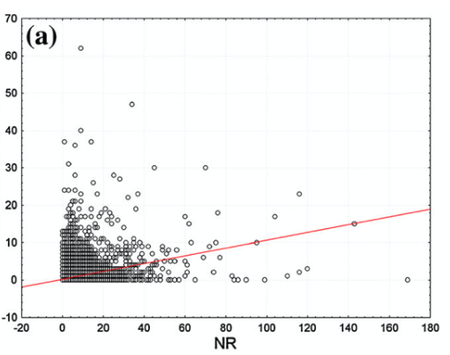
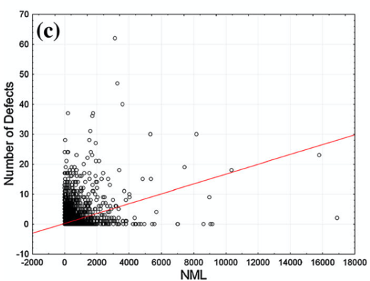
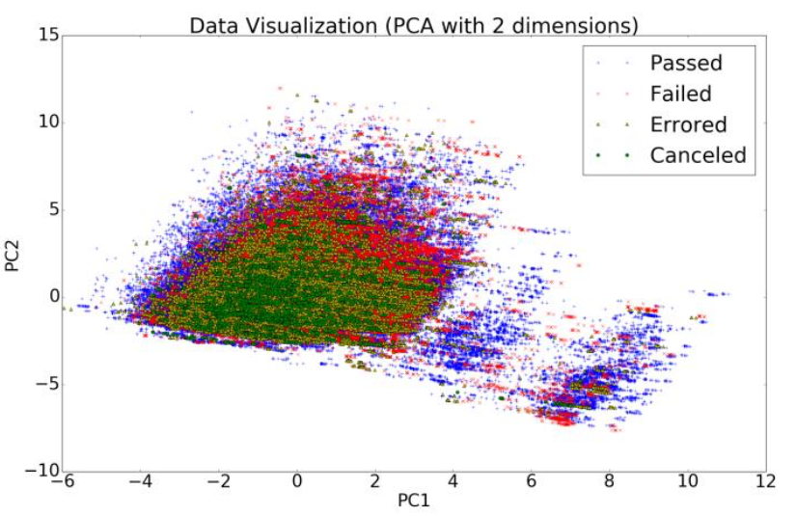
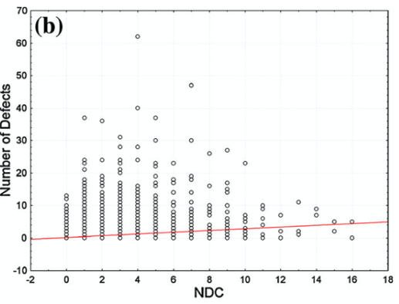
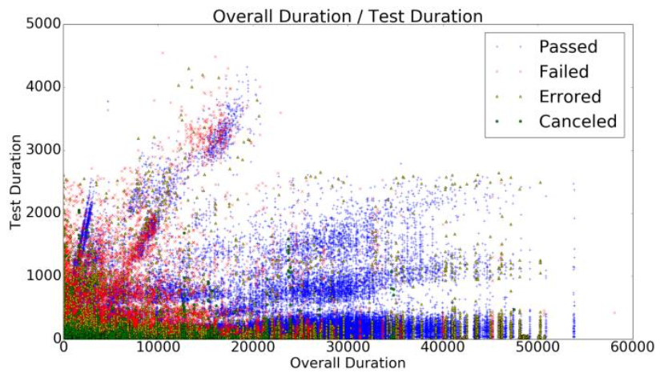
TravisTorrent Data-Mining
Preprocessing
Remove duplicates
Model
Analysis
Validation
Clustering
Useful Metrics
Select features
Convert types
Cleanse
Linear Regression
# of Revisions
# of Distinct Committers
# of Previous Defects
# of Modified Lines
Principal Component Analysis (PCA)
git_trigger_commit
gh_project_name
gh_pushed_at
tr_status
source: [17’ Dimitropoulos][17’ Madeyski]
Notes:
Parsing columns from CI data set 55 -> 28
Preprocessing:
Principal Component Analysis (PCA the data seems to have no strong correlations between passed and broken builds.
Result:
Most Useful defect prediction models were NDC and NML.
NML metric reflects the size of the change better than just looking a the lines of code of a project
NDC metric it is always probable that they will misunderstand one another’s intentions and overwrite the modifications made by their colleagues, which may, in turn, result in defects.
NR and NDPV are highly correlated

Slide 10
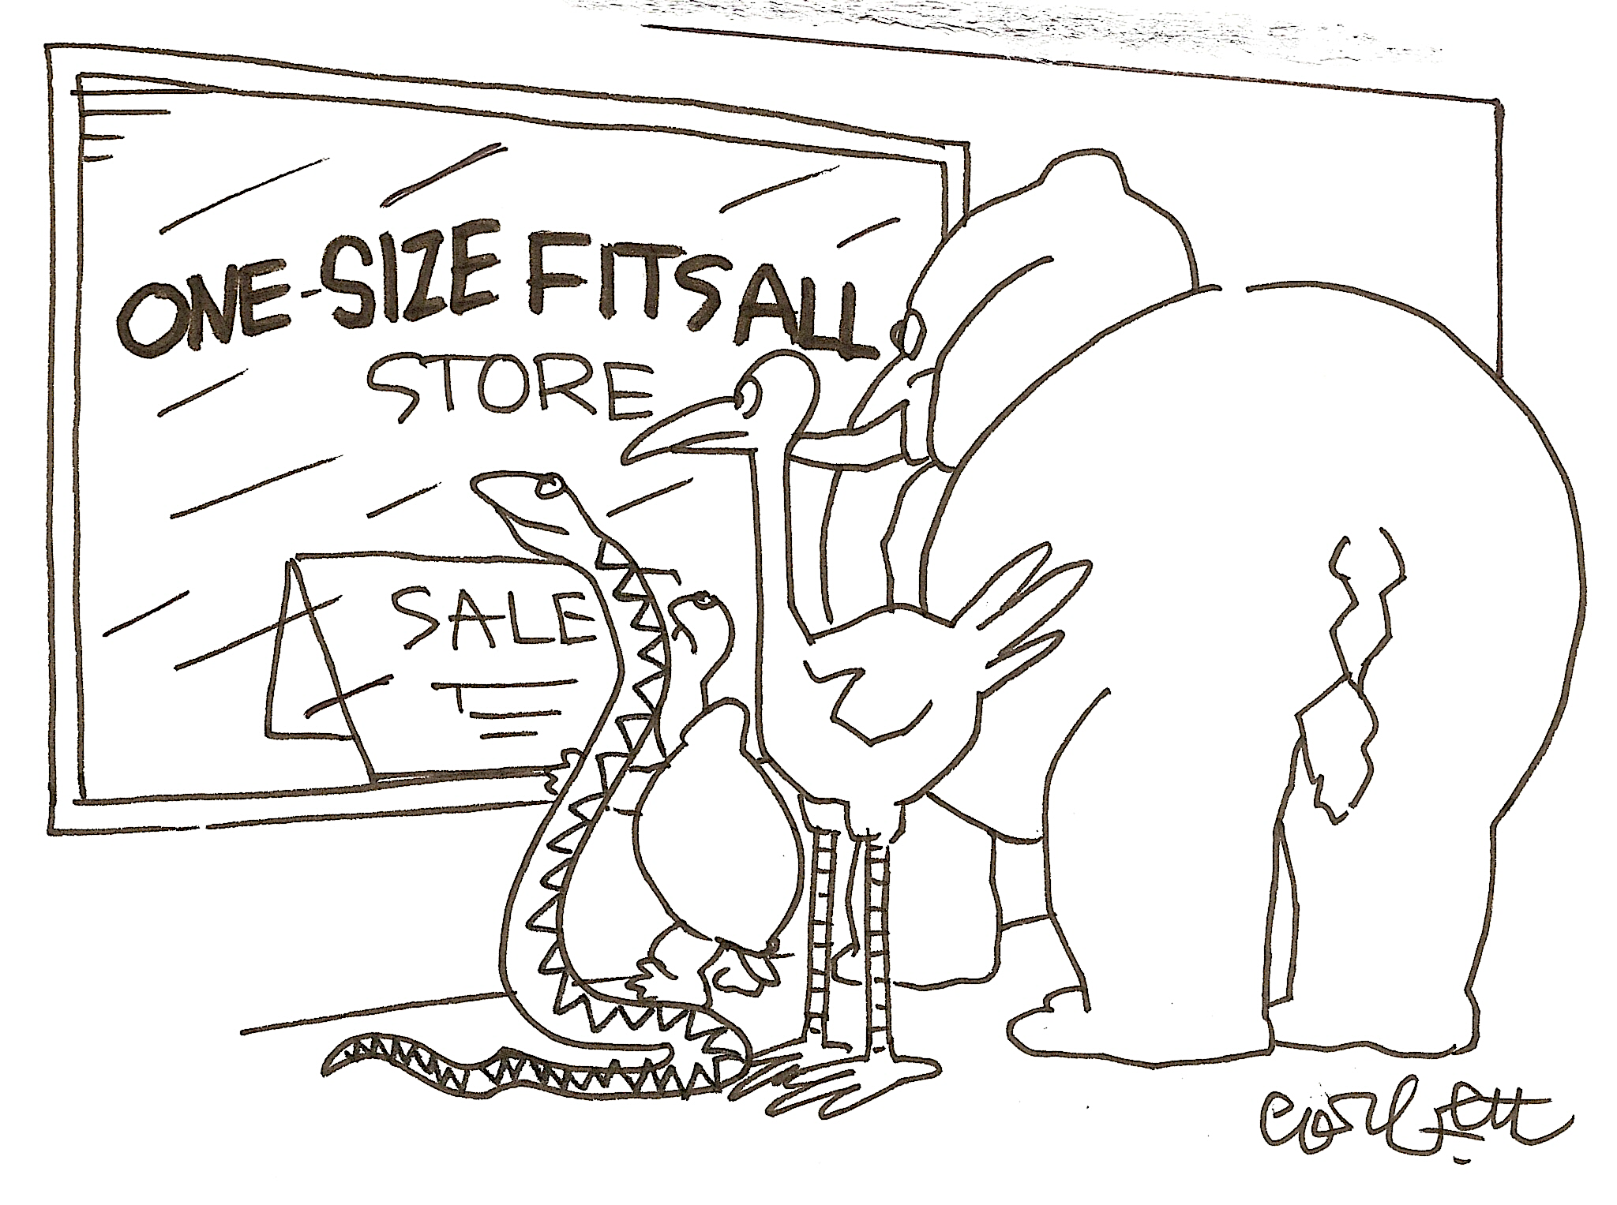


Challenges
Future Work
Conclusion
extension to more CI sources
new metrics/indicators/techniques/model
Cost evaluation in Big Data era (4V)
No “One size fits all” method
source: compendian
Notes:
No “One size fits all” golden DQ method: domain knowledge
Challenges: Cost in Big Data era(4Vs)
Volume: data
Velocity: growth in data
Variety: data types, higher processing capability
Value: low-value density
Future: Circle CI, Jenkins, other open source or industry project source-project

Slide 11


Everything in a Nutshell
git_trigger_commit
gh_project_name
gh_pushed_at
tr_status
Data
Quality
Type
Problem
Dimension
Define
Measure
Analyze
Improve
Revisions
Distinct Committers
Modified Lines
Previous Defects
Complete
Economic
Operational
Audit
Notes:
Killer Slides

Slide 12
Reference
[11’Borek] A. Borek, P. Woodall, M. Oberhofer, and A. K. Parlikad. A classification of data quality assessment methods. 2011.
[15’ Cai] L. Cai and Y. Zhu. The challenges of data quality and data quality assessment in the big data era. In Data Science Journal, page 2, 2015.
[09’Batini] C. Batini, C. Cappiello, C. Francalanci, and A. Maurino. Methodologies for data quality assessment and improvement. volume 41, New York, NY, USA, July 2009. Association for Computing Machinery.
[17’Beller] M. Beller, G. Gousios, and A. Zaidman. Travistorrent: Synthesizing travisci and github for full-stack research on continuous integration. In 2017IEEE/ACM 14th International Conference on Mining Software Repositories(MSR), pages 447–450, 201
[17’ Dimitropoulos] P. Dimitropoulos, Z. Aung, and D. Svetinovic. Continuous integration buildbreakage rationale: Travis data case study. In 2017 International Conference on Infocom Technologies and Unmanned Systems (Trends and Future Direc-tions) (ICTUS), pages 639–645, 2017
[17’ Madeyski] L. Madeyski and M. Kawalerowicz. Continuous defect prediction: The idea and a related dataset. In 2017 IEEE/ACM 14th International Conference on Mining Software Repositories (MSR), pages 515–518, 2017

